Slide 1
Working Group Call for Participation
March 2023
Notes:
Hello!
I’m Verena Beckham, from Codeplay Software and me and my colleague, Ken Wenger from CoreAVI, would like to invite you to join the SYCL SC Working Group

Slide 2
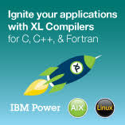
SYCL Single Source C++ Parallel Programming
One-MKL
One-DNN
OneDPC
SYCL-BLAS
SYCL-Eigen SYCL-DNN SYCL Parallel STL
...
Complex ML frameworks can be directly compiled and accelerated
C++ Libraries
Standard C++ Application Code
ML Frameworks
C++ Template Libraries
C++ Template Libraries
C++ Template Libraries
C++ templates and lambda functions separate host & accelerated device code
C++ Kernel Fusion can give better performance on complex apps and libs than hand-coding
SYCL Compiler
CPU Compiler
CPU
Other Backends
SYCL accelerates C++-based engines and applications with performance portability
SYCL 2020 Launched February 2021
Closer alignment with C++17
Smaller code size, faster performance
New Features
Unified Shared Memory | Parallel Reductions | Subgroup Operations | Class template Argument Deduction
Accelerated code passed into device OpenCL compilers
CPU
CPU
CPU
GPU
CPU
GPU
CPU
GPU
CPU
GPU
FPGA
DSP
FPGA
DSP
AI/Tensor HW
AI/Tensor HW
Custom Hardware
Custom Hardware
Notes:
Now let’s look at the two higher-level Khronos standards being used in the embedded industry. SYCL is a C++ language framework that uses template libraries to dispatch selected parts of a standard C++ application to acceleration processors. SYCL enables complex C++-based applications and libraries, such as complete machine learning frameworks, to be directly compiled and accelerated to performance levels that in many cases outperform hand-tuned code. Offloaded C++ code is sent to the SYCL compiler for the target accelerator processors, that often uses OpenCL as a backend, the remainder of the C++ code is sent to the C++ compiler for the host CPU.

Slide 3
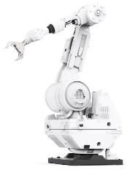
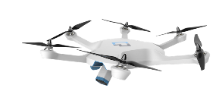
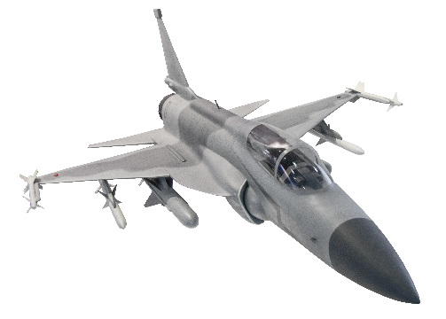
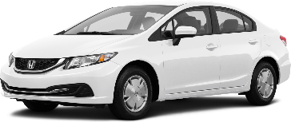
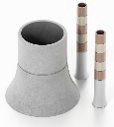
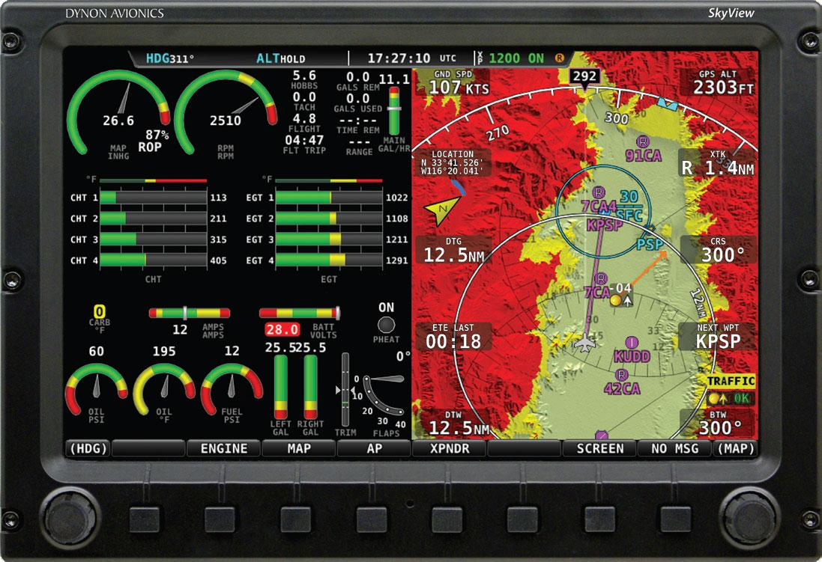
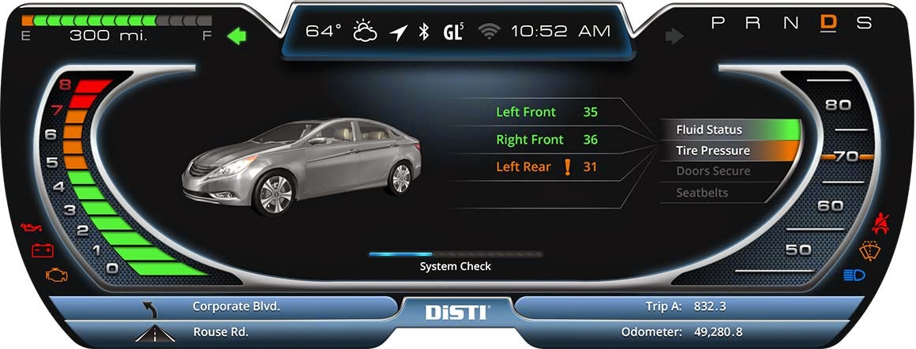
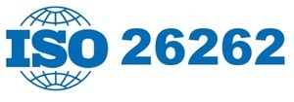
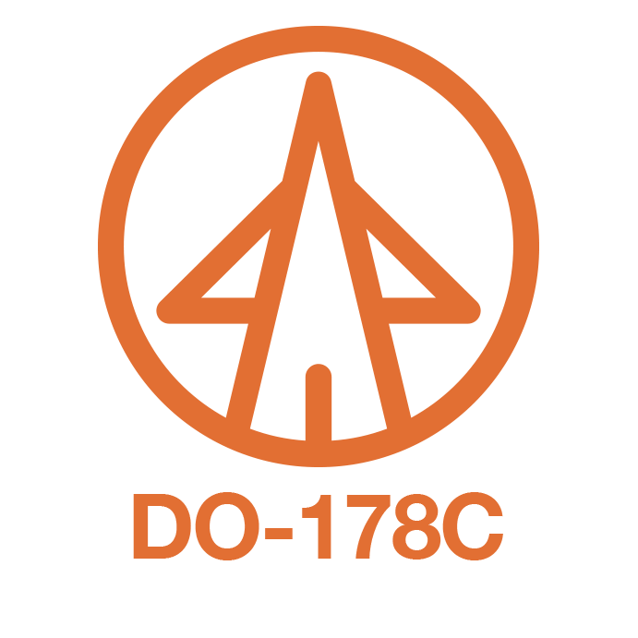
Growing Need for APIs for Functional Safety
Demand for advanced GPU-accelerated graphics and compute is growing in an increasing number of industries where safety is paramount, such as automotive, autonomy, avionics, medical, industrial, and energy
1990s
Avionics
2010s
Automotive
2020s…
Everywhere
Safety-critical APIs reduce system-level functional safety certification effort and costs 1) Streamlined functionality to reduce documentation and testing 2) Deterministic behavior to simplify system design and testing
3) Unambiguous API with minimized undefined behavior
4) Comprehensive and robust error/fault handling
Industry safety-critical standards include RTCA DO-178C (avionics) | ISO 26262 ASIL D (automotive)
IEC 61508 (industrial) | IEC 62304 (medical)

Slide 4
SYCL SC Exploratory Forum Results
Dramatic increases in software and hardware complexity in safety-critical markets
Including autonomous vehicles and devices
Widespread need for sophisticated acceleration of AI and heterogeneous parallel computing
Creating the demand for powerful, high-level programming abstractions
C++ programming model to unlock parallel acceleration is vital
SYCL’s use of single source C++17 adds significant value to software productivity, portability and reuse
Was open to any company with no cost or patent licensing obligations
Khronos SYCL Safety-Critical
Exploratory Forum
Explored industry requirements for high-level compute APIs suitable for safety-critical markets
Online discussions and Zoom calls March 2022 to March 2023
Built consensus that a standardization initiative to leverage SYCL for functional safety would add industry value
A SYCL-derivative to streamline system-level functional safety certification is of value and interest to the industry
Working Group Scope of Work
Notes:
Proven Khronos Exploratory Process to ensure industry requirements are fully understood before starting standardization initiatives

Slide 5
Khronos Safety Critical Standards Evolution
OpenGL ES 1.0 - 2003
Fixed function graphics
OpenGL ES 2.0 - 2007
Programmable Shaders
Vulkan 1.2 - 2020
Explicit Graphics and Compute and Display
OpenGL SC 1.0 - 2005
Fixed function graphics safety-critical subset
OpenGL SC 2.0 - 2016
Programmable Shaders
Safety-critical subset
Vulkan SC 1.0 - 2022
Explicit Graphics, Compute and Display safety-critical subset
Khronos has 20 years experience in standards for safety-critical markets
Leveraging proven mainstream standards with shipping implementations and developer tooling and familiarity
A choice of abstraction levels to suit different markets and developer needs
March 2023
SYCL SC Working Group announced to develop C++-based heterogeneous parallel compute programming framework for safety-critical systems
OpenVX SC Extension – 2017
Graph-based vision and inferencing
SYCL 2020
C++-based heterogeneous parallel programming
OpenVX 1.3 – 2019
SC Extension integrated into core OpenVX specification

Slide 6
SYCL SC Design Philosophy
SYCL SC will use the same definition and scope of “safety critical” as Vulkan SC
to reduce system-level functional safety certification effort and costs
Deterministic
Predictable execution times and results simplify design and test
Robust
Comprehensive error handling, remove ambiguity, eliminate undefined behavior
Simplified
Streamline functionality to reduce documentation and testing
Minimize Divergence
Between SYCL and SYCL SC with SYCL SC aiming to be a subset of SYCL wherever possible
Flexible Development
Enable SYCL SC to use off-the-shelf C++ compiler, for debugging, emulation, simulation and testing
No C++ language extensions
Add features via C++ libraries
Notes:
SYCL SC will use the same definition and scope of “safety-critical” as Vulkan SC, to remain compatible.
The three aims are
•Deterministic execution, which means the execution times and results should always be the same on every run, given the same input
•Robustness, which includes solid error handling, removing ambiguity and documenting undefined behaviour
•And Simplification, which means reducing the effort that is required for the implementation of a runtime to be certified according to safety standards

Slide 7
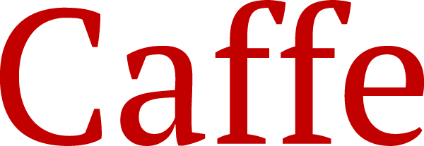
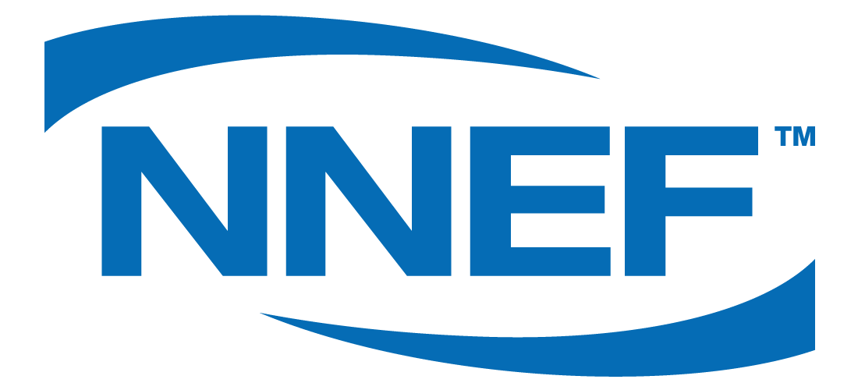
SYCL SC in the Khronos SC Ecosystem
Neural network models are trained in the cloud using a variety of platforms
SYCL SC bridges the gap between ML frameworks and low-level APIs with a high-level C++ programming framework
Others …
Decisions
Data Processing
Trained models may be exported and converted to NNEF for import to inferencing run-time
Safety-critical Vision and AI Applications
OpenVX provides high-level graph-based description of vision processing and neural networks. The Safety Critical Profile enables rapid deployment of safety-certified inferencing
SYCL SC provides a general parallel programming API for accelerated C++ compute - enabling proprietary algorithms involving data pre-processing, post-processing, and complex decision making
SC PROFILE
Vulkan SC or OpenCL are lower, execution-level APIs that can optionally be used to accelerate higher-level APIs like SYCL SC & OpenVX
Others …
Notes:
We expect artificial intelligence and vision applications to be the main use case for such a high-level API.
This is how SYCL SC would fit into the AI ecosystem.
Applications consist of a combination of neural network models, decision making and various glue code, such as data processing.
The neural net models can be generated using a variety of platforms, such as PyTorch or Tensorflow.
The model can be converted into the Neural Network Exchange Format NNEF defined by Khronos before being passed into the API for inferencing.
The application can make use of OpenVX’s safety-critical profile to perform the Vision and AI tasks, and the more general compute and the proprietary algorithms are accelerated by SYCL SC.
On a lower level Vulkan SC can be targeted as a backend to the higher level APIs, to allow the whole stack to be safety certified.

Slide 8
Get Involved to Help Shape SYCL SC
Join the Khronos SYCL SC Working Group
The SYCL SC Working Group is open to any Khronos member, and Khronos membership is open to any company.
https://www.khronos.org/members/ or email memberservices@khronosgroup.org
SYCL SC Working Group meetings starting in late March 2023
https://www.khronos.org/syclsc
Participate to influence Khronos’ growing family of open, royalty-free standards for embedded and safety-critical markets

